Slide 1
Production

Slide 2
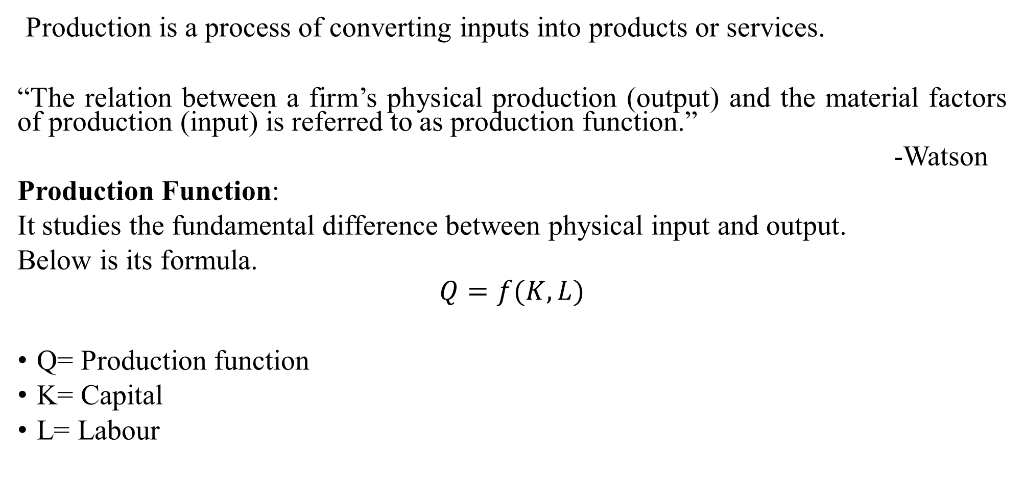
Production:
Production
Production is a process of converting inputs into products or services.
“The relation between a firm’s physical production (output) and the material factors of production (input) is referred to as production function.”
-Watson
Production Function:
It studies the fundamental difference between physical input and output.
Below is its formula.
$$Q=f(K,L)$$
Q= Production function
K= Capital
L= Labour

Slide 3
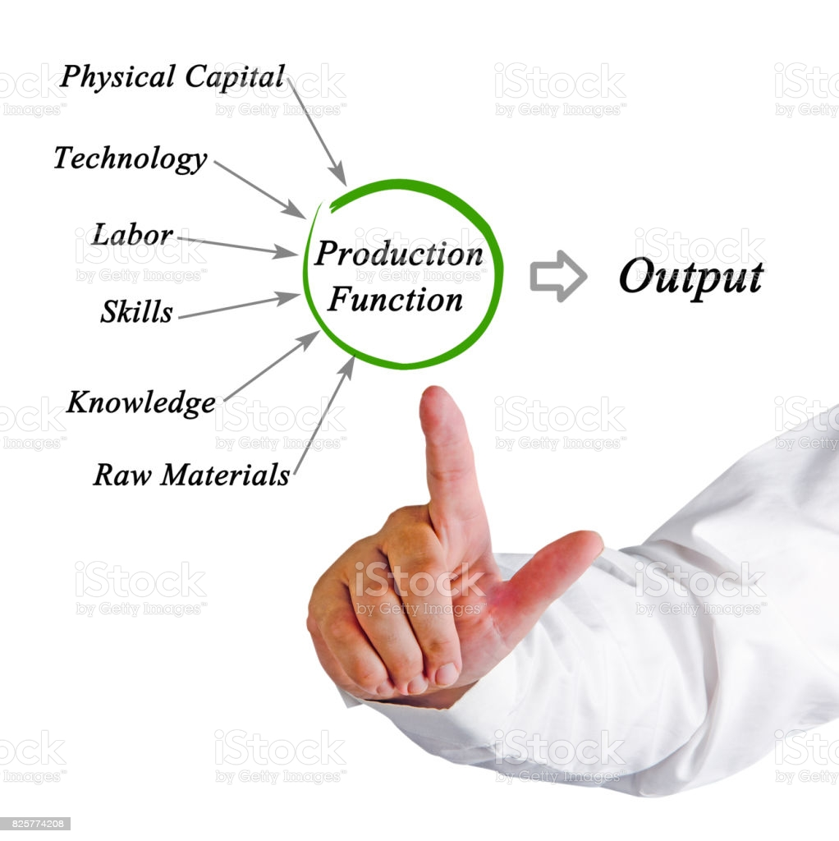
Production
The production function neither provide any information on the least cost capital, nor does it reveal the output rate that will yield the maximum profit.
The production function simply reveal the maximum output that can be obtained from any and all input combination.

Slide 4
Concept of Product
Production
Total product-
It refers to the total amount of output that a firm produces within a given period, utilising given inputs.
Total Product= Average product∗ Labour
TP =AP x Unit of lab
Average Product-
Total product per unit of factor employed in the production process.
Average Product= Total product∕ Labour

Slide 5
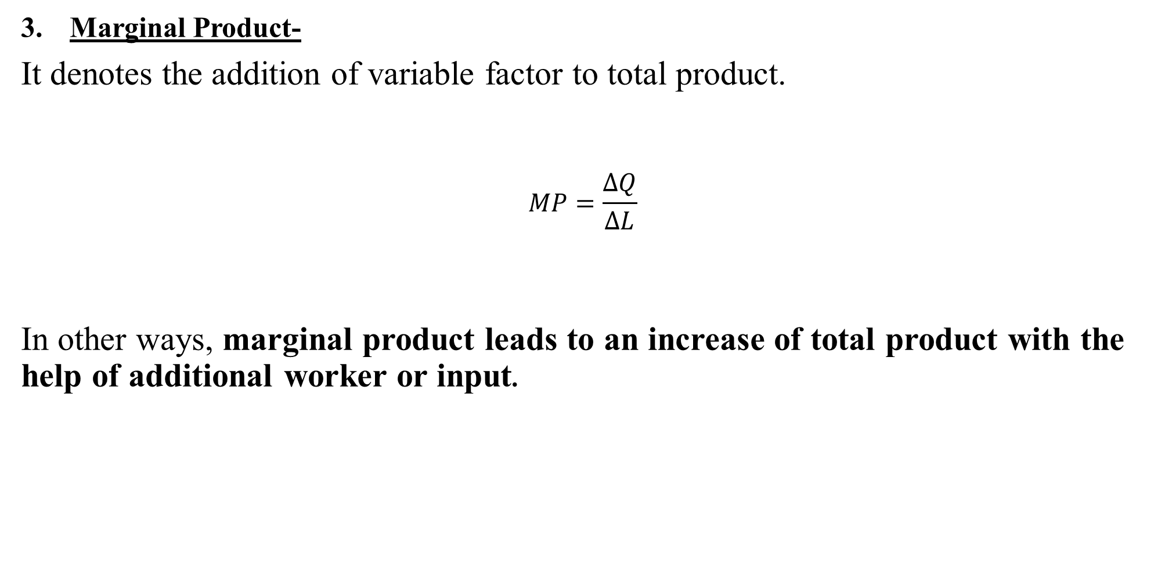
Production
Marginal Product-
It denotes the addition of variable factor to total product.
$$MP=\frac{ΔQ}{ΔL}$$
In other ways, marginal product leads to an increase of total product with the help of additional worker or input.

Slide 6
Relationship between Total Product and Marginal Product:
Production Function
Fix Factor Land(acre) | Variable Factor Labour (Units) | TP (Units) | MP (Units) | AP (Units)
1 | 1 | 10 | 10 | 10
1 | 2 | 30 | 20 | 15
1 | 3 | 60 | 30 | 20
1 | 4 | 80 | 20 | 20
1 | 5 | 90 | 10 | 18
1 | 6 | 90 | 0 | 15
1 | 7 | 80 | -10 | 11.4
1 | 8 | 60 | -20 | 7.5

Slide 7
Relationship between Marginal Product and Total Product:
When MP increases ,TP increases at an increasing rate,.
When MP declines at diminishing rate ,TP increases at decreasing.
When MP zero TP reaches its maximum.
When MP decreases and becomes negative then TP decreases.
Marginal Product = ∑ Total Production
MP | TP
↑ | ↑at ↑ rate
↓ (+tive) | ↑at ↓ rate
0(Zero) | Maximum
↓(-tive) | ↓

Slide 8
Relationship between Average Product and Marginal Product:
Production
Marginal product remains above an average product when AP rises.
Average product and marginal product become equal at the maximum AP.
Similarly, MP remains below AP, in case AP declines.
MP becomes negative and AP declines but will always be greater than zero
AP | MP
↑ | MP greater than AP
↓ | MP less than AP
Maximum | MP=AP

Slide 9
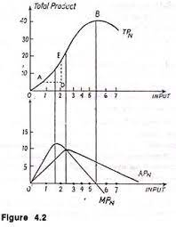
Production

Slide 10
Law of Production Function
Laws of Variable proportion- Law of Diminishing Return ( Short run production function with at least one input is variable)
Laws of Return scales – Long run production function with all inputs factors are variable.

Slide 11
Laws of Variable proportion-
Meaning: Only one factor is increased( Variable ) keeping other factors constant (fixed)
In terms of TP: It implies with the given quantity of fixed factors, initially TP will increase at increasing rate then decreasing rate and reaches to Maximum and finally decline
In terms of MP: Initially MP increases then it decreases to Zero but remains positive and finally while declining it becomes negative.
Assumptions:
Technology constant
One factor Variable and other are fixed
All VF are identical/ equally efficient
Short period of operation
Factors of productions are not perfect substitutes

Slide 12
Explanation of Law
Production Function
Fix Factor Land(acre) | Variable Factor Labour (Units) | TP (Units) | MP (Units) | Teturns to VF | Stages of Production
1 | 1 | 5 | 5 | TP ↑ at ↑rate MP ↑ | Stage 1 Stage of increasing returns
1 | 2 | 15 | 10
1 | 3 | 30 | 15
1 | 4 | 40 | 10 | TP↑at ↓rate MP (+ive) | Stage 2 Stage of decreasing returns
1 | 5 | 45 | 5
1 | 6 | 45 | 0
1 | 7 | 40 | -5 | TP↓ MP↓(-ive) | Stage 3 Stage of negative returns
1 | 8 | 30 | -10

Slide 13
C
TP
B
Total
product
A
Labor
MP_{L}
A
Marginal product
B
C Labor
L_{A}
L_{B}
L_{C}

Slide 14
Logic behind
Reason: Initially there is underutilization of fixed Factor. As VF increases efficiency increases
At one point pressure on Fix factors increases which leads to fall in productivity of the VF
There is too much of VF in relation to FF

Slide 15
Causes of Increasing Returns
Optimum combination of Factors
Fuller optimization of Fixed factors
Division of Labour and specialization
Volume discount
Causes of Diminishing Returns
Scarcity of resources
Use beyond optimum capacity: if disturbed- MP will be lesser
Lack of perfect substitute
Management problem

Slide 16
References
Production Function
Dwivedi D N, Managerial Economics, Vikas Publishing House Pvt. Ltd, 2006
Samuelson, Paul A; Nordhaus, William D. (2014). Economics. Boston, Mass: Irwin McGraw-Hill.

